Slide 1
Customer, BankAccount and Chequing Account Trace
Group T01-03

Slide 2
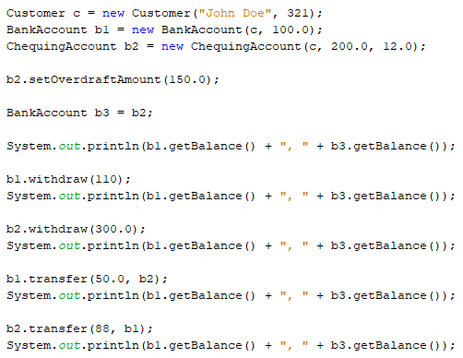
A new Customer object is created, where c is the instance variable that holds the memory address of this object.
The instance variables of c1 are initialized as follows:
Name = “John Doe”
customerID = 321

Slide 3
A new BankAccount object is created, where b1 is the instance that refers to this object
The instance variables of b1 are initialized as follows:
accountholder = c
Balance = 100.0
Note that one of b1’s variables is in fact the reference to our Customer object.

Slide 4
A new ChequingAccount object is created, where b2 is the instance that refers to this object.
The instance varibles of b2 are initialized as follows:
accountHolder = c
balance = 200.0
overdraftFee = 12.0
Note that accountholder and balance variables are inherited from BankAccount parent class.

Slide 5
b2 is a reference to a specific object of type ChequingAccount. This object has its own instances variables; overdraftFee and overdraftAmount.
The setter method is called which sets the value of overdraftAmount:
overdraftAmount=150.0

Slide 6
Declare a new variable of type BankAccount.
The assignment statement sets b3 to be the memory address of the object for which b2 refers.
b3 is now a second reference to the same object that b2 refers to.
Note that this does not copy or create a new object.

Slide 7

D

Slide 8

D

Slide 9

D

Slide 10
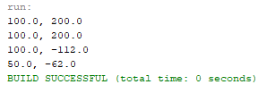
D

Slide 11
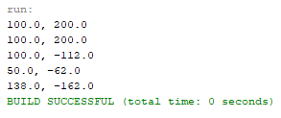
D

